Slide 1


Course Code: HSS-451
Course Title: Accounting & Finance
Class Day: Friday Timing:
08:30am to 10:30am
11:30am to 01:30pm
Lecture / Week No. 09
Instructor Name: Asim Iqbal
Department of Management Sciences

Slide 2

Table Of Contents
S.R# | Contents | Page #
1. | Define internal control | 6
2. | Explain the Sarbanes-Oxley Act | 9
3. | List and describe the components of internal control and control procedures | 12
4. | Explain control procedures unique to e-commerce | 23
5. | Demonstrate the use of a bank account as a control device | 26
6. | Prepare a bank reconciliation and the related journal entries | 28
7. | Apply internal controls to cash receipts | 42
8. | Apply internal controls to cash payments | 45
9. | Explain and journalize petty cash transactions | 51
10. | Describe ethical business issues related to accounting | 61
11. | Reference | 70

Slide 3
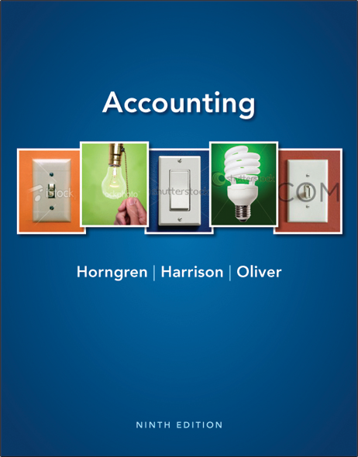
Internal Control & Cash
Chapter 7
Notes:
1
1
1
1
1
Chapter 7 explains internal control and cash.

Slide 4





Learning Objectives
 | Define internal control
 | Explain the Sarbanes-Oxley Act
 | List and describe the components of internal control and control procedures
 | Explain control procedures unique to e-commerce
 | Demonstrate the use of a bank account as a control device
Notes:
The learning objectives of this chapter include to:
1. Define internal control.
2. Explain the Sarbanes-Oxley Act.
3. List and describe the components of internal control and control procedures.
4. Explain control procedures unique to e-commerce.
5. Demonstrate the use of a bank account as a control device.

Slide 5





Learning Objectives
 | Prepare a bank reconciliation and journalize the related entries
 | Apply internal controls to cash receipts
 | Apply internal controls to cash payments
 | Explain and journalize petty cash transactions
 | Identify ethical dilemmas in an internal control situation
Notes:
Additional objectives include to:
6. Prepare a bank reconciliation and journalize the related entries.
7. Apply internal controls to cash receipts.
8. Apply internal controls to cash payments.
9. Explain and journalize petty cash transactions.
10. Identify ethical dilemmas in an internal control situation.

Slide 6

Define internal control
Notes:
The first learning objective is to define internal control.

Slide 7
Internal Control
Organizational plan and all the related measures to:
Safeguard assets
Encourage employees to follow company policies
Promote operational efficiency
Ensure accurate, reliable accounting records
Notes:
This chapter presents a framework for safeguarding assets and building policies employees should follow. It also shows how to account for cash, the most liquid of all assets. A key responsibility of a business manager is to control operations. Owners set goals, hire managers to lead the way, and hire employees to carry out the business plan. Internal control is the organizational plan and all the related measures designed to:
1. Safeguard assets: A company must protect its assets; otherwise it is throwing away resources. If you fail to safeguard your cash, the most liquid of assets, it will quickly slip away.
2. Encourage employees to follow company policy: Everyone in an organization needs to work toward the same goals.
3. Promote operational efficiency: Businesses cannot afford to waste resources.
4. Ensure accurate, reliable accounting records: Accurate, reliable accounting records are essential. Without reliable records, managers cannot tell which part of the business is profitable and which part needs improvement.
How critical are internal controls? They are so important that the U.S. Congress passed a law requiring public companies—those that sell their stock to the general public—to maintain a system of internal controls.

Slide 8
S7-1: Definition of internal control
Internal controls are designed to safeguard assets, encourage employees to follow company policies, promote operational efficiency, and ensure accurate accounting records.
Requirements
Which objective is most important?
2. Which must the internal controls accomplish for the business to survive? Give your reason.
Safeguarding assets is most important.
Businesses need to safeguard assets to survive. If this is not done, assets may slip away which is ultimately throwing away resources.
Notes:
Short Exercise 7-1 focuses on internal controls that are designed to safeguard assets, encourage employees to follow company policies, promote operational efficiency, and ensure accurate accounting records.

Slide 9
2
Explain the Sarbanes-Oxley Act
Notes:
The second learning objective is to explain the Sarbanes-Oxley Act.

Slide 10
Sarbanes-Oxley Act (SOX)
Congress passed SOX after the Enron and WorldCom scandals
Provisions include:
Public companies must issue an internal control report
Created Public Company Accounting Oversight Board (PCAOB) to oversee auditors
Accounting firms may not both audit and provide consulting services to the same company
Stiff penalties for violators (20–25 years in prison)
Notes:
The Enron and WorldCom accounting scandals rocked the United States. Enron overstated profits and went out of business almost overnight. WorldCom (now part of Verizon) reported expenses as assets and overstated both profits and assets. Significantly, the same accounting firm, Arthur Andersen, had audited both companies’ financial statements. Arthur Andersen voluntarily closed its doors in 2002, after nearly 90 years in public accounting.
To address public concern, Congress passed the Sarbanes-Oxley Act, abbreviated as SOX. SOX revamped corporate governance in the United States and affected the accounting profession. Here are some of the SOX provisions:
Public companies must issue an internal control report, and an outside auditor must evaluate the client’s internal controls. Additionally, an outside auditor must evaluate the client’s internal controls and report on the internal controls as part of the audit report.
2. A new body, the Public Company Accounting Oversight Board, oversees the work of auditors of public companies.
3. Accounting firms may not both audit a public client and also provide certain consulting services for the same client.
4. Stiff penalties await violators—25 years in prison for securities fraud; 20 years in prison for an executive making false sworn statements.

Slide 11
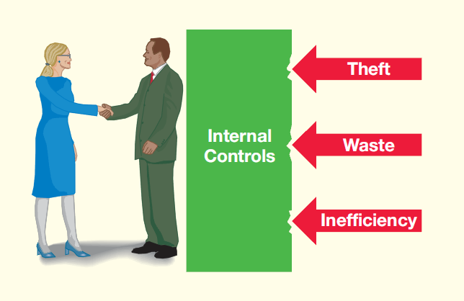
The Shield of Internal Control
Notes:
This exhibit shows the shield that internal controls provide for an organization.

Slide 12
3
List and describe the components of internal control and control procedures
Notes:
The third learning objective is to list and describe the components of internal control and control procedures.

Slide 13
Components of Internal Control
Monitoring of controls
Information System
Control procedures
Control Environment
Risk Assessment
MICER
Acronym for the five components
Notes:
A business can achieve its internal control objectives by applying five components. TIP: You can remember the five components by using the acronym MICER. This stands for Monitoring of controls, Information system, Control procedures, Control Environment and Risk assessment.

Slide 14
Monitoring of Controls
Hire auditors to monitor controls
Internal Auditors
Employees of the company
Check for company policy adherence
Determines if legal requirements are followed
External Auditors
Not employees
Completely independent of the business
Monitor controls on financial statement presentations
Suggest improvements
Notes:
Companies hire auditors to monitor their controls. Internal auditors are employees of the business who ensure that employees are following company policies and that operations are running efficiently. These internal auditors also determine whether the company is following legal requirements that monitor internal controls to safeguard assets.
External auditors are outside accountants that are completely independent of the business. They monitor the controls to ensure that the financial statements are presented fairly in accordance with GAAP and they suggest improvements to help the business.

Slide 15
Information System
Information is critical
Decision makers need accurate information
Controls in place to:
Prevent unauthorized access to accounting systems
Insure adequate approvals for transactions
Notes:
As we have seen, the information system is critical. Decision makers need accurate information to keep track of assets and measure profits and losses. Controls must be in place within the information system to ensure that only authorized users have access to various parts of the accounting information system. Additionally, controls are needed to insure that adequate approvals for recorded transactions are in place.

Slide 16
Control Procedures and Control Environment
Control Procedures
Designed to ensure goals are achieved
Control Environment
The “tone at the top” of the business
Starts with the C.E.O. and top managers
Behave honorably to set examples
Demonstrate importance of internal control
Notes:
Control procedures are the procedures designed to ensure that the business’s goals are achieved.
The control environment is the “tone at the top” of the business. It starts with the owner or C.E.O. and the top managers. They must behave honorably to set a good example for company employees. Each must demonstrate the importance of internal controls if he or she expects the employees to take the controls seriously. Former executives of Enron and WorldCom failed to establish a good control environment and are in prison as a result.

Slide 17
Risk Assessment
Risk Assessment
Examples: Foods may prove harmful, planes may crash, companies face bankruptcy
When facing difficulties, management is tempted to falsify financial statements
Notes:
A company must assess its risks. For example, Kraft Foods faces the risk that its food products may harm people; American Airlines planes may crash; Sony faces copyright infringement risks; and all companies face the risk of bankruptcy. Companies facing difficulties are tempted to falsify the financial statements to make themselves look better than they really are.

Slide 18
Internal Control Procedures
Hire competent, reliable, and ethical personnel
Assignment of responsibilities
Separation of duties
Separate operations from accounting
Separate the custody of assets from accounting
Audits
Review the internal control system and test controls
Documents provide details of transaction
Electronic Devices
Electronic documents and digital storage devices
Notes:
All companies need the following internal control procedures:
Competent, reliable, and ethical personnel: Employees should be competent, reliable, and ethical. Paying good salaries will attract high-quality employees. Employees should also be trained to do the job and their work should be adequately supervised.
Assignment of responsibilities: In a business with good internal controls, no important duty is overlooked. Each employee has certain responsibilities. Clearly assigned responsibilities create job accountability, thus ensuring that all important tasks get done.
Separation of duties: Smart management divides responsibility between two or more people. Separation of duties limits fraud and promotes the accuracy of the accounting records. Separation of duties can be divided into two parts:
Separate operations from accounting
Separate the custody of assets from accounting
Audits: To assess their accounting records, most companies have an audit. An audit is an examination of the company’s financial statements and accounting system. To evaluate the accounting system, auditors must examine the internal controls.
Documents: Documents provide the details of business transactions. Documents include invoices and fax orders. Documents should be pre-numbered to prevent theft and inefficiency. A gap in the numbered sequence draws attention.

Slide 19
Internal Control Procedures
Other controls
Fireproof vaults
Alarms and security cameras
Loss-prevention specialists
Bonding employees
Mandatory vacations
Job rotation
Notes:
The types of other controls are as endless as the types of businesses that exist. The key to controls is that the cost of the control should not exceed the benefit (savings) from implementing that control. Some examples of other common controls are:
Fireproof vaults to store important documents.
Burglar alarms, fire alarms, and security cameras to protect buildings, inventory, and other property.
Loss-prevention specialists to train company employees to spot suspicious activity.
Fidelity bonds purchased for employees who handle cash.
Mandatory vacations and job rotation to improve internal control.

Slide 20
E7-14: Identifying internal controls
Consider each situation separately. Identify the missing internal control procedure from these characteristics:
● Assignment of responsibilities
● Separation of duties
● Audits
● Electronic controls
● Other controls (specify)
While reviewing the records of Quality Pharmacy, you find that the same employee orders merchandise and approves invoices for payment.
Separation of duties
Notes:
Exercise 7-14 directs you to identify internal controls.

Slide 21
E7-14: Identifying internal controls
b. Business is slow at Amazing Amusement Park on Tuesday, Wednesday, and Thursday nights. To reduce expenses, the owner decides not to use a ticket taker on those nights. The ticket seller (cashier) is told to keep the tickets as a record of the number sold.
c. The same trusted employee has served as cashier for 12 years.
Separation of duties
Other controls (no job rotation)
Notes:
The exercise continues on this slide.

Slide 22
E7-14: Identifying internal controls
When business is brisk, Quickie Mart deposits cash in the bank several times during the day. The manager at one store wants to reduce the time employees spend delivering cash to the bank, so he starts a new policy. Cash will build up over weekends, and the total will be deposited on Monday.
Grocery stores, such as Convenience Market and Natural Foods, purchase most merchandise from a few suppliers. At another grocery store, the manager decides to reduce paperwork. He eliminates the requirement that the receiving department prepare a receiving report listing the goods actually received from the supplier.
Other controls (not depositing cash soon enough for adequate security)
Other controls (documents and records—no receiving report).
Notes:
The exercise continues on this slide.

Slide 23
4
Explain control procedures unique
to e-commerce
Notes:
The fourth learning objective is to explain control procedures unique to e-commerce.

Slide 24
Internal Controls for E-Commerce
Risks
Stolen credit card numbers and passwords
Computer viruses and Trojans
Phishing Expeditions
Security measures
Encryption
Firewalls
Notes:
E-commerce creates its own unique types of risks:
Stolen account numbers or passwords
Computer viruses and trojans
Phishing expeditions
To address the risks posed by e-commerce, companies have devised a number of security measures, including encryption and firewalls.

Slide 25
The Limitations of Internal Control
Collusion:
Two or more employees work together to defraud the company
Cost:
The stricter the internal control, the greater the cost
Notes:
Unfortunately, many internal controls can be overcome. Collusion—two or more people working together—can beat internal controls. In addition, the stricter the internal control system, the more it costs. Internal controls must always be judged in light of their costs versus their benefits.

Slide 26
5
Demonstrate the use of a bank account as a control device
Notes:
The fifth learning objective is to demonstrate the use of a bank account as a control device.

Slide 27

Control Documents of a Bank Account
Cash
Most liquid asset
Medium of exchange
Bank accounts establish practices for safeguarding cash
Bank account controls
Signature card
Deposit tickets
Checks
Bank Statement
Electronic funds transfer
Bank reconciliation
Notes:
Cash is the most liquid asset because it’s the medium of exchange. Cash is easy to conceal and relatively easy to steal. As a result, most businesses create specific controls for cash. Keeping cash in a bank account helps control cash because banks have established practices for safeguarding customers’ money. The documents used to control a bank account include:
Signature card
Deposit ticket
Check: There are three parties to a check:
the maker, who signs the check
the payee, to whom the check is paid
the bank on which the check is drawn
Bank statement
Electronic funds transfer (EFT)
Bank reconciliation

Slide 28
6
Prepare a bank reconciliation and the related journal entries
Notes:
The sixth learning objective is to prepare a bank reconciliation and the related journal entries.

Slide 29
Two Records of Business’s Cash
Cash account in general ledger
T-account debits and credits
Bank Statement
Shows cash receipts and payments
Each shows a different balance
Timing differences
Outstanding checks and deposits
EFT transactions
Bank Reconciliation
Explains all differences between cash record and the bank record
Preparer should have no other cash duties
Notes:
There are two records of a business’s cash:
The Cash account in the company’s general ledger.
The bank statement, which shows the cash receipts and payments transacted through the bank.
The book and the bank statement usually show different cash balances. Differences arise because of a time lag in recording transactions, called a timing difference. The bank reconciliation explains all differences between your cash records and your bank’s records of your balance. The person who prepares the bank reconciliation should have no other cash duties. This means that the reconciler should not be a person who has access to cash or has duties requiring journalizing cash transactions. Otherwise, he or she could steal cash and manipulate the reconciliation to conceal the theft.

Slide 30
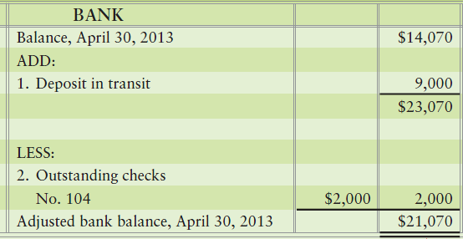
Bank Reconciliation
Bank side
Items not yet recorded by bank
Deposits in transit
Outstanding checks
Bank Errors
Notes:
This is the format of a bank reconciliation. There are two “sides” – a bank side and a book side. The bank side contains items not yet recorded by the bank but recorded by the company or errors made by the bank, such as:
Deposits in transit (outstanding deposits)
Outstanding checks
Bank errors

Slide 31
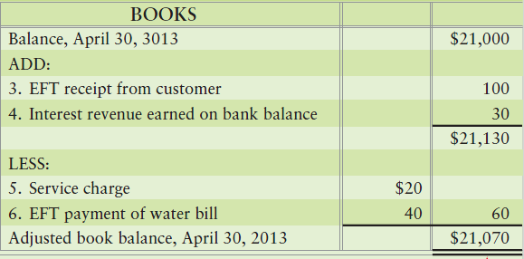
Bank Reconciliation
Book Side
Item not recorded in the books
Bank collections
EFT transactions
Service charges
Interest revenue
Nonsufficient funds checks
Cost of printed checks
Book errors
Notes:
The book side contains items not yet recorded by the company on its books, but already recorded by the bank, or errors made by the company, such as:
Bank collections
Electronic funds transfers
Service charge
Interest revenue on a checking account
5. Nonsufficient funds (NSF) checks
6. The cost of printed checks
7. Book errors

Slide 32
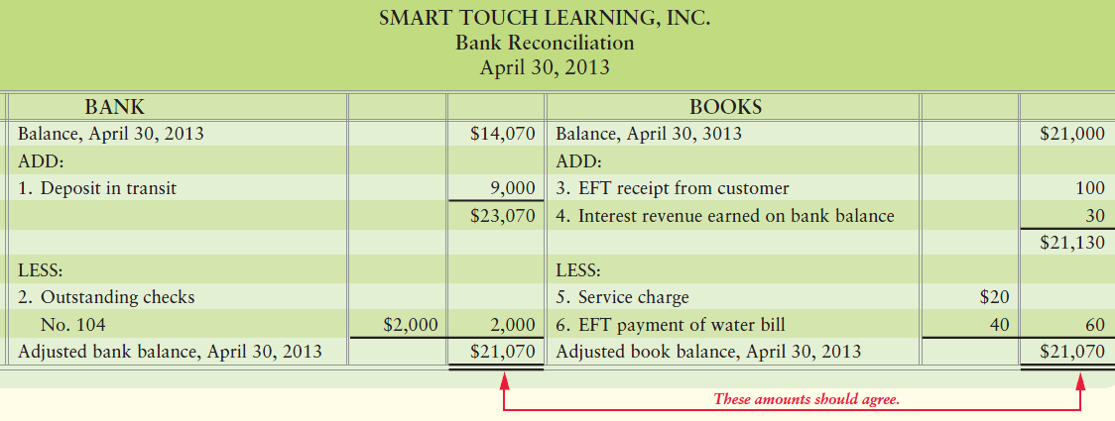
Bank Reconciliation
Notes:
The bank statement shows that the April 30 bank balance of Smart Touch is $14,070 (upper-right corner). However, the company’s Cash account has a balance of $21,000. This situation calls for a bank reconciliation to explain the differences. This example shows the completed reconciliation.

Slide 33
Summary of the Reconciling Items
BANK BALANCE—ALWAYS
Add deposits in transit.
Subtract outstanding checks.
Add or subtract corrections of bank errors.
BOOK BALANCE—ALWAYS
Add bank collections, interest revenue, and EFT receipts.
Subtract service charges, NSF checks, and EFT payments.
Add or subtract corrections of book errors.
Notes:
For the bank balance, always:
Add deposits in transit.
Subtract outstanding checks.
Add or subtract corrections of bank errors.
For the book balance, always:
Add bank collections, interest revenue, and EFT receipts.
Subtract service charges, NSF checks, and EFT payments.
Add or subtract corrections of book errors.

Slide 34
E7-17 : Classifying bank reconciliation items
The following items could appear on a bank reconciliation:
Outstanding checks, $670.
Deposits in transit, $1,500.
NSF check from customer, #548 for $175.
Bank collection of our note receivable of $800, and interest of $80.
(4) A subtraction from the bank balance
(3) An addition to the bank balance
(2) A subtraction from the book balance
(1) An addition to the book balance
Notes:
Exercise 7-17 reviews classifying bank reconciliation items.

Slide 35
E7-17 : Classifying bank reconciliation items
The following items could appear on a bank reconciliation:
e. Interest earned on bank balance, $20.
f. Service charge, $10.
g. Book error: We credited Cash for $200. The correct amount was $2,000.
Bank error: The bank decreased our account by $350 for a
check written by another customer.
(1) An addition to the book balance
(2) A subtraction from the book balance
(2) A subtraction from the book balance
(3) An addition to the bank balance
Notes:
The exercise continues on this slide.

Slide 36
Journalizing Transactions from the Reconciliation
Any item under “book balance” requires a journal
entry to adjust the Cash account
Notes:
The bank reconciliation is an accountant’s tool separate from the journals and ledgers. It does not account for transactions in the journal. To get the transactions into the accounts, we must make journal entries and post to the ledger. All items on the book side of the bank reconciliation require journal entries. We make no entries on the bank side, because we do not have access to the bank’s general ledger.

Slide 37
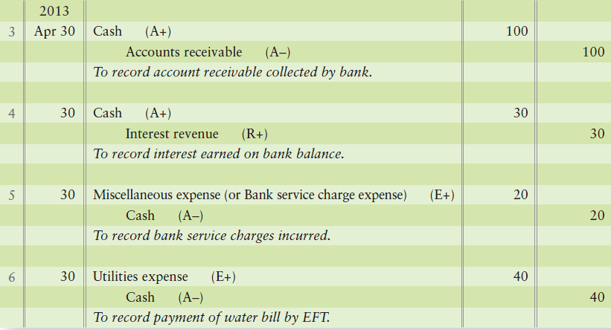
Journalizing Transactions from the Reconciliation
Notes:
To record bank collections of a customer’s account receivable, Cash is debited and Accounts receivable is credited. To record interest revenue, cash is Debited and Interest revenue is credited. Note that the items added to the book side of the reconciliation both have debits to cash.
Bank service charges, including charges for printed checks, are debited to Miscellaneous expense. If the bank statement indicates a customer’s check that was previously deposited was returned due to nonsufficient funds, Accounts receivable is debited. The company will attempt to collect the funds from the customer in the future. Note that the items subtracted on the book side of the reconciliation are credited to Cash.
After all the entries are posted, the Cash account in the general ledger will equal the adjusted balance on the reconciliation.

Slide 38
Online Banking
Pay bills and view bank account electronically
Prepare a bank reconciliation any time
Allows the company to:
Reconcile to the checkbook online
Pay bills online
Set up automatic payments for its bills
Promote a paperless/green approach
Electronic notification of bank statements and/or transactions
Secure online delivery of the same
Notes:
Online banking allows a company to pay its bills and view its bank account electronically—the company does not have to wait until the end of the month to get a bank statement. With online banking, the company can reconcile transactions at any time and keep its account current whenever the company wishes.
The transaction history—like a bank statement—lists deposits, checks, EFT payments, ATM withdrawals, and interest earned on your bank balance. More and more banks today make it much easier to do the reconciliations. They not only have running daily balances available on the history, but they also have various icons that allow the company to reconcile to the checkbook online, pay bills online, and set up automatic payments for its bills. In addition, banks promote a paperless/green approach with electronic notification of bank statements and/or transactions and secure online delivery of the same. Banks also offer integration of the company’s accounts to Excel and other popular financial packages like QuickBooks and Peachtree. The result: Paper statements and checks are becoming obsolete.

Slide 39
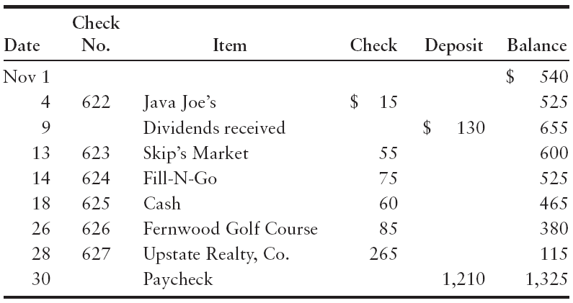
E7-18 : Preparing a bank reconciliation
D. J. Harrison’s checkbook lists the following:
Notes:
Exercise 7-18 focuses on preparing a bank reconciliation.

Slide 40
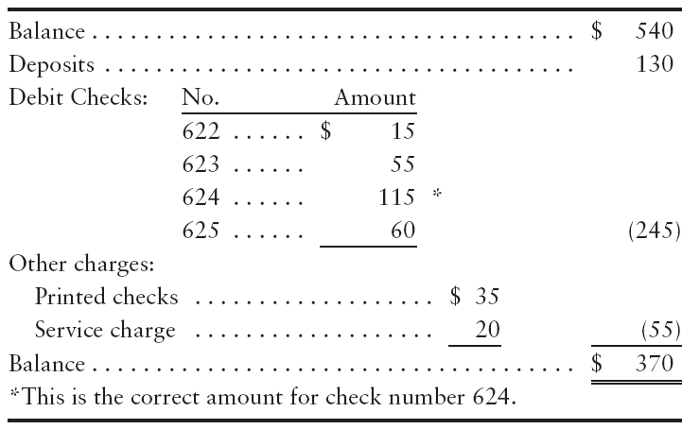
E7-18 :Preparing a bank reconciliation
Harrison’s November bank statement shows the following:
Notes:
The exercise continues on this slide.

Slide 41
E7-18 : Preparing a bank reconciliation
1. Prepare Harrison’s bank reconciliation at November 30, 2012.
D.J.
Bank Reconciliation
November 30, 2012
BANK:
Balance, November 30, 2012 |  | $ 370
Add: Deposit in transit |  | _1,210
 |  | 1,580
Less: Outstanding checks:
Check Number: 626 | $ 85
627 | 265 | __350
Adjusted bank balance, November 30, 2012 |  | $1,230
BOOKS:
Balance, November 30, 2012 |  | $1,325
Less: Correction of book error | $40
Cost of checks | 35
Bank service charge | _20 | ___95
Adjusted book balance, November 30, 2012 |  | 1,230
Notes:
The exercise continues.

Slide 42
7
Apply internal controls to cash receipts
Notes:
The seventh learning objective is to apply internal controls to cash receipts.

Slide 43
Cash Receipts Over the Counter
Receipt is issued for each transaction
Cash drawer opens when a transaction is entered
Cash Register records transaction
At the end of a shift, manager proves cash
Prevents theft
At least once a day, cashier deposits cash in bank
Register tape sent to accounting department
Notes:
The point-of-sale terminal (cash register) provides control over the cash receipts. For each transaction, a receipt is issued to ensure that each sale is recorded. The cash drawer opens when the clerk enters a transaction, and the machine (cash register) records it. At the end of the day, a manager proves the cash by comparing the cash in the drawer against the machine’s record of sales. This step helps prevent theft by the clerk. At the end of the day—or several times a day if business is brisk—the cashier deposits the cash in the bank. The machine tape then goes to the accounting department to record the journal entry to record cash receipts and sales revenue. These measures, coupled with oversight by a manager, discourage theft.

Slide 44
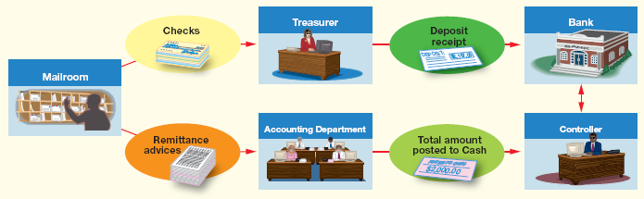

Cash Receipts by Mail
Mailroom employee opens mail
Checks are sent to treasurer and cashier deposits money
Remittance advice sent to accounting for journal entries
Controller compares records of
The day’s bank deposit amount from treasurer
The debit to Cash made by the accounting department
Notes:
Many companies receive cash by mail. All incoming mail is opened by a mailroom employee. The mailroom then sends all customer checks to the treasurer, who has the cashier deposit the money in the bank. The remittance advices go to the accounting department for journal entries to Cash and customer accounts. As a final control, the controller compares these records for the day:
• Bank deposit amount from the treasurer
• Debit to Cash from the accounting department
The debit to Cash should equal the amount deposited in the bank. All cash receipts are safe in the bank, and the company books are up-to-date.

Slide 45
8
Apply internal controls to cash payments
Notes:
Learning objective eight is to apply internal controls to cash payments.

Slide 46
Controls over Payment by Check
Paying by check is an important internal control
The check provides a record of the payment
The check must be signed by an authorized official
Before signing the check, the official reviews the relevant documentation
Notes:
As we have seen, companies need a good separation of duties between operations and writing checks for cash payments. Payment by check is an important internal control for the following reasons:
● The check provides a record of the payment.
● The check must be signed by an authorized official.
● Before signing the check, the official reviews the invoice or other evidence supporting the payment.

Slide 47
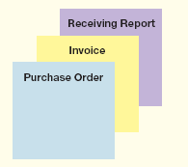
Controls over Purchase and Payment
Purchasing Process follows 4 steps
STEP 1: Send a purchase order to order items
STEP 2: The items are sent and an invoice is sent to the purchaser
STEP 3: Inventory is received and a receiving report is prepared.
STEP 4: After approving all documents, a check is sent for the amount invoiced.
Purchasing should be separate from receiving
Notes:
To illustrate the internal control over cash payments by check, suppose Smart Touch buys its inventory from Sony. The purchasing and payment process follows these steps, as shown in Exhibit 7-10. Start with the box for Smart Touch on the left side:
Step 1: Smart Touch e-mails a purchase order to Sony that states, “Please send us 1,000 DVD-Rs.”
Step 2: Sony ships the goods and e-mails an invoice back to Smart Touch.
Step 3: Smart Touch receives the inventory and prepares a receiving report.
Step 4: After approving all documents, Smart Touch sends a check to Sony.
For good internal control, the purchasing agent should neither receive the goods nor approve the payment.

Slide 48
The Voucher System
A sequentially numbered document authorizing cash payment
Includes:
Vouchers
Voucher register
Check register
Notes:
Many companies use the voucher system for internal control over cash payments. A voucher is a sequentially numbered document authorizing a cash payment. The voucher system uses (1) vouchers, (2) a voucher register (similar to a purchases journal discussed in an online chapter), and (3) a check register (similar to a cash payments journal, also discussed in the online chapter). All expenditures must be approved before payment. This approval takes the form of a voucher.

Slide 49
S7-10 : Internal control over cash payments by check
A purchasing agent for Franklin Office Supplies receives the goods that he purchases and also approves payment for the goods.
How could this purchasing agent cheat his company?
Approve payment for an excessive amount and split the excess with the supplier.
Purchase goods and have them delivered to his/her home.
Notes:
Short Exercise 7-10 addresses internal control over cash payments by check.

Slide 50
S7-10 : Internal control over cash payments by check
A purchasing agent for Franklin Office Supplies receives the goods that he purchases and also approves payment for the goods.
2. How could Franklin avoid this internal control weakness?
Companies avoid this internal control weakness by separating the following duties:
Purchasing goods
Receiving goods
Approving payments for goods
Notes:
The exercise continues on this slide.

Slide 51
9
Explain and journalize petty cash transactions
Notes:
Learning objective nine explains and journalizes petty cash transactions.

Slide 52
Petty Cash
Cash fund on site to pay for small expenditures
Controls needed:
Designate a custodian of petty cash fund
Keep a specific amount of cash on hand
All payments are supported with a petty cash ticket
Notes:
We have already established that cash is the most liquid of assets. Petty cash is more liquid than cash in the bank because none of the bank controls are in place. Therefore, petty cash needs controls such as the following:
Designate a custodian of the petty cash fund.
Designate a specific amount of cash to be kept in the petty cash fund.
Support all petty cash fund payments with a petty cash ticket.

Slide 53

Setting Up The Petty Cash Fund
Check written for specific amount and cashed
Check is made payable to Petty cash
Journal entry:
Debit Petty cash
Credit cash
Notes:
The petty cash fund is opened when you write a check for the designated amount. Make the check payable to Petty cash. The journal entry is a debit to Petty cash and a credit to Cash.

Slide 54
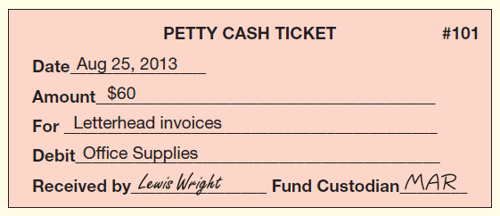
Making Payments
Petty cash ticket is a receipt
Is prepared when payments are made using the fund
It includes::
Date
Amount
Account involved
Person receiving the funds
Custodian issuing the funds
Notes:
For each petty cash payment, the custodian prepares a petty cash ticket. Signatures (or initials) identify the recipient of the cash and the fund custodian. The custodian keeps the petty cash tickets in the fund box.

Slide 55
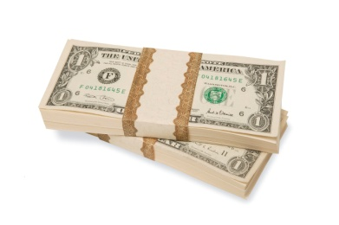
Imprest System
Maintaining petty cash at its designated balance
Petty cash plus the receipts should always equal designated balance
Process is the main internal control feature
Notes:
Maintaining the Petty cash account at its designated balance is the nature of an imprest system. The imprest system requires that, at any point in time, the petty cash box contains cash and receipts that total the amount of the imprest balance. This clearly identifies the amount of cash for which the custodian is responsible, and that is the system’s main internal control feature. Payments deplete the fund, so periodically the fund must be replenished.

Slide 56
Replenish Petty Cash
Total the amounts on petty cash tickets
Petty cash tickets plus cash remaining in fund
Should equal petty cash fund balance
Missing amount is debited or credited to Cash short and over
Journal entry is prepared to record expenditures
A new check is cashed to replenish the fund
Cash is then placed in petty cash box
Notes:
To replenish the petty cash fund, you need to bring the cash on hand up to the original balance. To do this, the tickets are totaled and the total is added to the cash remaining in the fund. This amount should equal the petty cash balance. Missing petty cash funds are either debited or credited to a new account, Cash short & over.
The petty cash tickets tell you what to debit and the check amount tells you what to credit. A journal entry is prepared debiting the appropriate accounts for the expenditures. A new check is cashed to replenish the fund, and the cash is placed in petty cash.

Slide 57
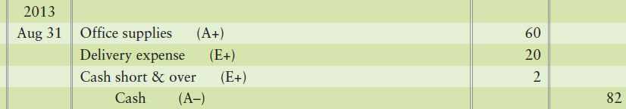
Cash Short and Over
New account
Used whenever a cash fund is short or over
May have either a debit or credit balance
Reported as expense or revenue depending on ending balance
Notes:
Missing petty cash funds are either debited (or credited) to a new account, Cash short & over. If $2 was missing, we debit Cash short & over for the missing petty cash. If there is $8 extra in the fund, the account is credited.

Slide 58
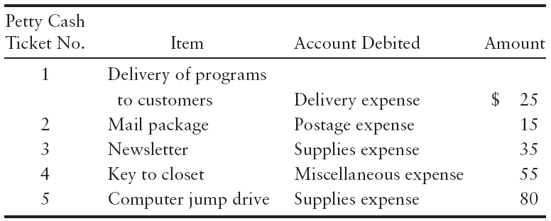
E7-22 : Accounting for petty cash
Karen’s Dance Studio created a $370 imprest petty cash fund. During the month, the fund custodian authorized and signed petty cash tickets as follows:
Notes:
Exercise 7-22 addresses accounting for petty cash.

Slide 59
E7-22 : Accounting for petty cash
Make the general journal entries to:
a. Create the petty cash fund and include explanations.
(a) |  | Petty Cash |  | 370
 |  | Cash in bank |  |  | 370
 |  | To open the petty cash fund.
Notes:
The exercise continues on this slide.

Slide 60
E7-22 : Accounting for petty cash
(Continued)
b. Record its replenishment. Cash in the fund totals $147, so $13 is missing. Include explanations.
(b) |  | Delivery expense |  | 25
 |  | Postage expense |  | 15
 |  | Supplies expense ($35 + $80) |  | 115
 |  | Miscellaneous expense |  | 55
 |  | Cash short and over |  | 13
 |  | Cash ($370 − $147) |  |  | 223
 |  | To replenish the petty cash fund.
Notes:
The exercise continues on this slide.

Slide 61
10
Describe ethical business issues related to accounting
Notes:
The last learning objective is to describe ethical business issues related to accounting.

Slide 62

Business Ethics
Analyzing right from wrong
Companies have a code of ethics
Accountants held to higher standard
Ethical decision making
Define the situation
Specify alternatives
Identify consequences
Make the decision
Notes:
President Theodore Roosevelt said, “To educate a person in mind and not in morals is to educate a menace to society.” Roosevelt knew unethical behavior does not work. Sooner or later it comes back to haunt you. Moreover, ethical behavior wins out in the long run because it is the right thing to do. Ethics in business is really a system of values, analyzing right from wrong.
Most companies have a code of ethics to encourage employees to behave ethically. But codes of ethics are not enough by themselves. Owners and managers must set a high ethical tone, as we saw in the earlier section in this chapter on Control Environment. The owner or CEO must make it clear the company will not tolerate unethical conduct.
Accountants are expected to maintain higher standards than society in general. Their ability to do business depends entirely on their reputation. Most independent accountants are members of the American Institute of Certified Public Accountants and must abide by the AICPA Code of Professional Conduct.

Slide 63
Chapter 7 Summary
Internal control systems are the rules and boundaries that help protect what the company owns, ensure that the company is operating efficiently within those rules, and ensure that the accounting reports accurately show transactions that have occurred.
The Sarbanes-Oxley Act changed the rules for auditors, limiting what services they can perform in addition to the audit and requiring the evaluation of internal controls. SOX also created the PCAOB to watch over the work of public company auditors.
Notes:
Internal control systems are the rules and boundaries that help protect what the company owns, ensure that the company is operating efficiently within those rules, and ensure that the accounting reports accurately show transactions that have occurred.
The Sarbanes-Oxley Act changed the rules for auditors, limiting what services they can perform in addition to the audit and requiring the evaluation of internal controls. SOX also created the PCAOB to watch over the work of public company auditors.

Slide 64
Chapter 7 Summary
Internal control procedures include hiring competent, reliable, and ethical personnel; assigning responsibility for various tasks so accountability may occur; separating key duties so that one person doesn’t have access, recording, and authorization functions; performing internal and external audits; and pre-numbering documents sequentially. The key to each of these controls is that the cost of the control should not exceed the benefit (savings) from implementing the control.
Notes:
Internal control procedures include hiring competent, reliable, and ethical personnel; assigning responsibility for various tasks so accountability may occur; separating key duties so that one person doesn’t have access, recording, and authorization functions; performing internal and external audits; and pre-numbering documents sequentially. The key to each of these controls is that the cost of the control should not exceed the benefit (savings) from implementing the control.

Slide 65
Chapter 7 Summary
Internal control for e-commerce changes constantly as technology continues to advance and new threats to online security appear. Protecting the company’s computer systems and thus the company’s electronic assets from these threats is a top priority when designing a company’s internal control system.
Bank account controls help safeguard the most liquid of company assets: cash. These controls include signature cards, deposit tickets, checks, bank statements, EFTs, and bank reconciliations.
Notes:
Internal control for e-commerce changes constantly as technology continues to advance and new threats to online security appear. Protecting the company’s computer systems and, therefore, the company’s electronic assets from these threats is a top priority when designing a company’s internal control system.
Bank account controls help safeguard the most liquid of company asset–cash. These controls include signature cards, deposit tickets, checks, bank statements, EFTs, and bank reconciliations.

Slide 66
Chapter 7 Summary
The bank statement, whether online or in paper form, identifies transactions that need to be recorded in the Cash account. The reconciliation is a control over cash.
Internal controls are designed to insure that all cash received gets to the company’s bank as quickly and securely as possible.
Internal controls are designed to insure that all cash payments are made in a timely manner for paying the actual bills of the company.
Notes:
The bank statement, whether online or in paper form, identifies transactions that need to be recorded in the Cash account. The reconciliation is a control over cash.
Internal controls are designed to insure that all cash received gets to the company’s bank as quickly and securely as possible; and that all cash payments are made in a timely manner to pay the actual bills of the company.

Slide 67
Chapter 7 Summary
Because petty cash is so liquid, the main control over petty cash is establishing one individual who has control and responsibility for the petty cash fund.
Internal controls should be designed to remove the opportunity for individuals to act unethically.
Notes:
Because petty cash is so liquid, the main control over petty cash is establishing one individual who has control and responsibility for the petty cash fund.
Internal controls should be designed to remove the opportunity for individuals to act unethically.

Slide 68

Notes:
Do you have any questions?

Slide 69

Copyright
All rights reserved. No part of this publication may be reproduced, stored in a retrieval system, or transmitted, in any form or by any means, electronic, mechanical, photocopying, recording, or otherwise, without the prior written permission of the publisher. Printed in the United States of America.

Slide 70
.
References / Resources
https://www.investopedia.com/terms/i/internalcontrols.asp
https://www.thebalance.com/sarbanes-oxley-act-of-2002-3306254
https://www.dummies.com/business/accounting/auditing/the-5-components-of-internal-controls/
https://www.solostream.com/general-requirements-for-e-commerce/
https://quizlet.com/75906665/the-bank-account-as-a-control-device-bank-reconciliation-flash-cards/
https://www.reference.com/web?q=prepare+bank+reconciliation&qo=boost&o=1191588&ad=SEO
https://work.chron.com/internal-control-procedures-receipt-cash-6735.html
https://courses.lumenlearning.com/sac-finaccounting/chapter/cash-receipts-and-disbursements/
https://www.accountingtools.com/articles/2017/5/14/petty-cash-accounting
https://www.purdueglobal.edu/blog/business/ethics/

